Slide 1
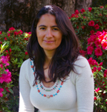
Hello There!
My name is Ana Rincon, I live in Cameron Park, CA. I wear many hats, but currently I am an artist and decorative designer, I am presently the co-owner of Rinconart Studio and Gallery in Placerville, California. I have worked as an independent instructor for many years. I look forward to developing my instructional design skills, I am thrilled to be part of this program, I really appreciate the mix of design and technology in the educational field. In the future, I would love to design my own courses or work on projects for various companies/organizations.

Slide 2
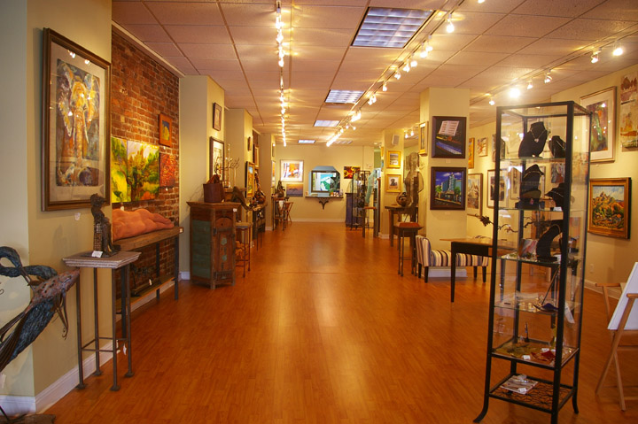
Background and facts
Bachelor of Arts in Studio Art – University of Texas at Austin
Independent studies in web design and graphics
Work experience in computers, administration, sales, education, photography, art instruction, design, and curriculum development
Over 10 years experience as an artist/painter
I co-own an art gallery in Placerville, California

Slide 3
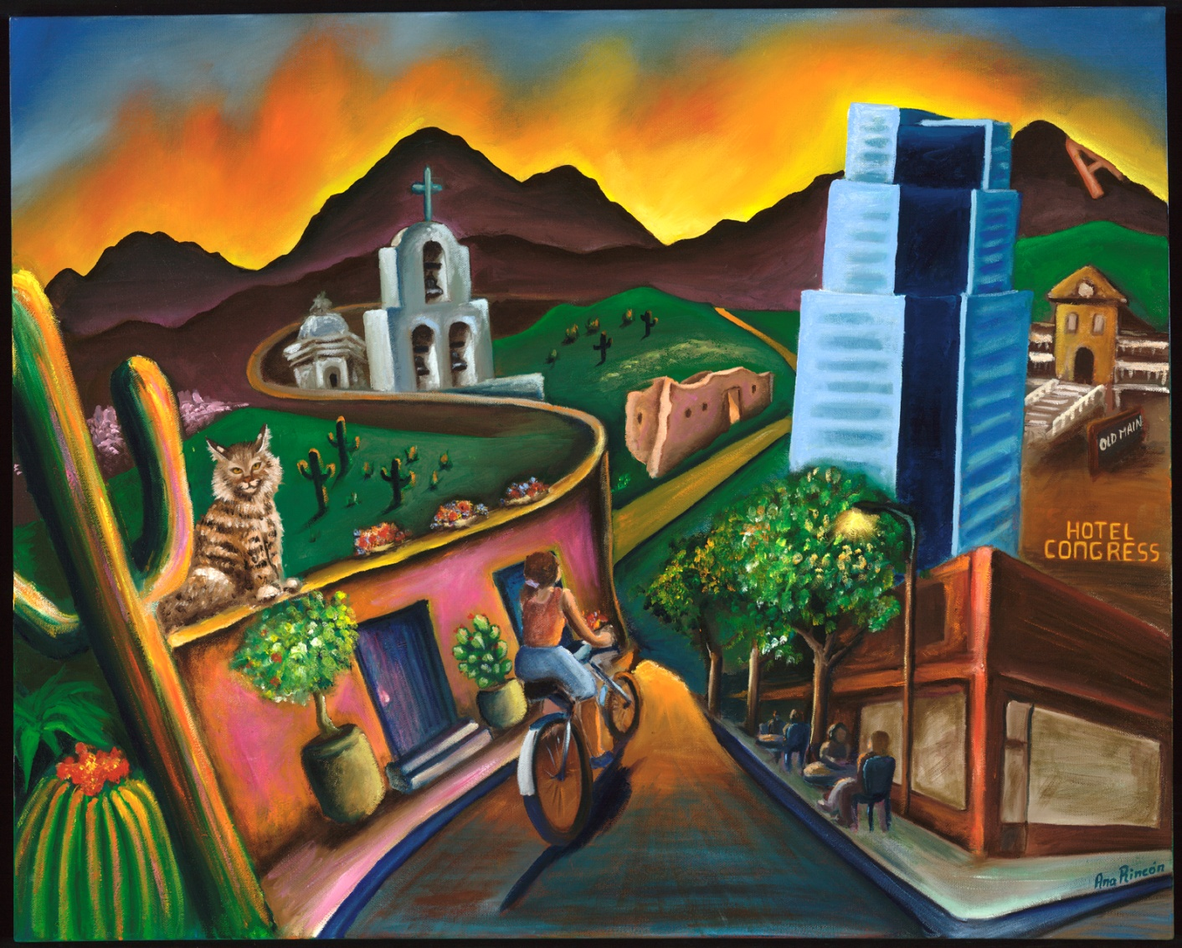
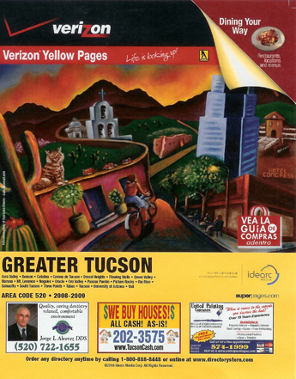
One of my art commissions
painting by the Verizon Yellow Book in Tucson, was featured on the cover of their 2009 edition.

